Slide 1
Product Features Extraction
Aug 2024
Notes:
V7 – Cover without image

Slide 2


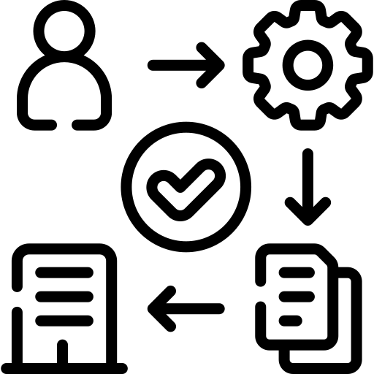
Enhancing Propensity Model Performance through Feature Engineering
Key Milestones
Objective
Leverage Gen AI to extract product related features like coverage, eligibility & other subtle information to enhance propensity model performance
Key Outcomes :
Key Product Features: Mine through current and historical product documents to analyze and extract product information in a structured format to be consumed by models
Automated Pipeline which can extract , update & maintain product matrix information which is currently done manually
Benefits
Propensity Model Performance : Product holding has a significant impact on model performance. Opportunity to experiment on the improvement in model performance with this additional set of new signals.
New Insights : Key input to understand the relation between Product Features & Propensity to purchase over historical data
Input for key use cases like mis-conduct, product recommendation & Plines support: Product matrix can act as metadata while embedding the documents into vector database which can improve relevance during retrieval
May
2024
Collect product documents both current and historical
Analysis to identify the key product signals to extract from the documents
Set up LLM models & packages required for the development
Data , Infra & scoping
June
2024
Prompt optimization to process and extract key information from the product documents
Validate the extracted information
Descriptive analysis on product types & features
PoC–CheckPnt #1
Features Extraction
July
2024
POC- CheckPnt #2
Integration with Upsell Model
Create a new feature group within A360 to store the product features
Run A360 for 2 years populating this information
Run Upsell life model to test the improvement in Lift
Standardize the pipeline to update given the new set of product documents
Aug
2024
Automated Pipeline for Product Matrix

Slide 3



Project Overview
Current Challenges
AI Solutions
Business Outcome
Currently, the manual processing of product information is not only time-consuming but also prone to errors.
We need a scalable solution to manage large volumes of unstructured policy documents. This project will provide that solution.
✅ Enhancement of existing predictive models
We lack a structured approach to maintaining and updating our product matrices, which affects the efficiency of our operations.
We will utilize GenAI to consolidate information into a structured JSON response.
✅ Policies are always either being updated or new policies are being implemented.
Process data quickly and efficiently, allowing our advisors to promptly adapt to the changes and meet customer needs.
✅ Pipeline can be extended to other projects
such as our chatbot.

Slide 4
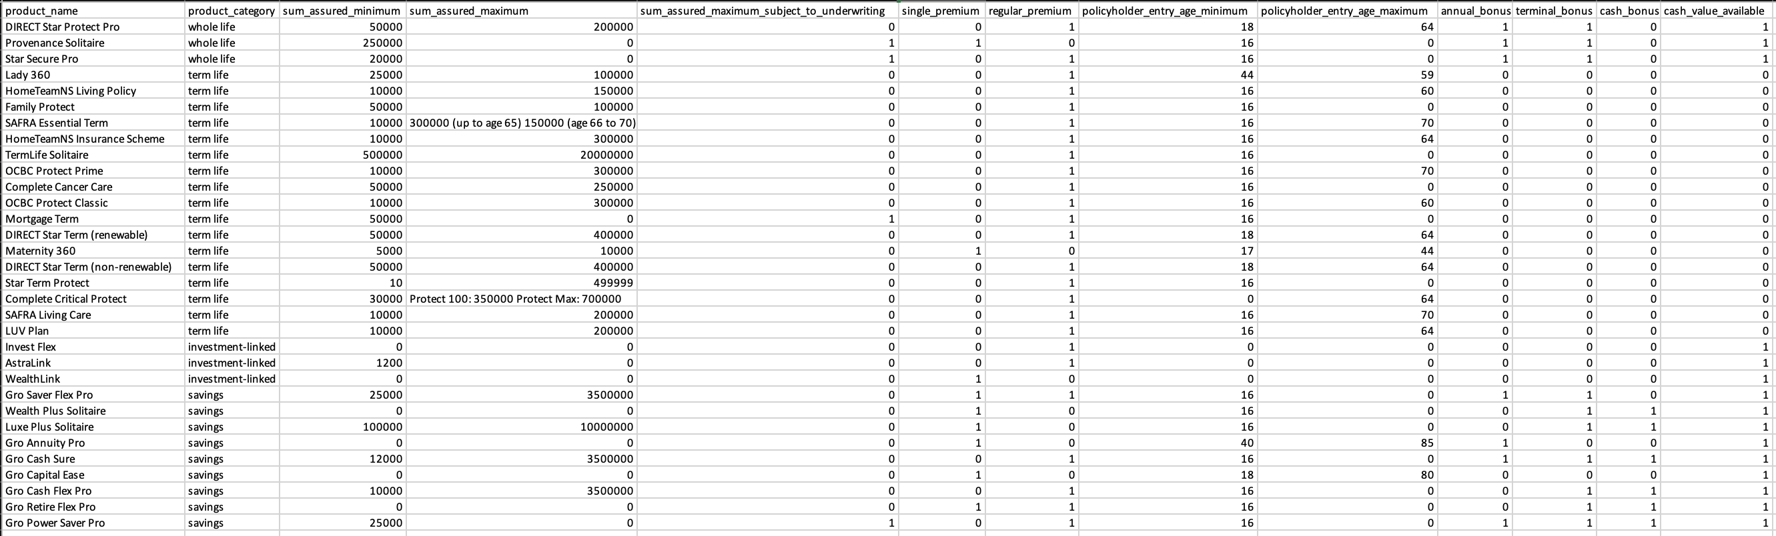


Snapshot
Final Output
Currently Captured Features
Product Name
Product Category
Sum Assured
Policyholder Entry Age
Minimum Protection Value
Single Premium
Regular Premium
Premium Payment Frequency Options
Investment Bonus (ILP)
Loyalty Bonus (ILP)
Annual Bonus
Terminal Bonus
Cash Bonus
Cash Value Available
Loans Available
Benefits
Optional Rider
Additional Eligibility Criteria
Backdating Allowed
Exclusions
Covered Destinations
Model Integration:
Can be passed into machine learning models for predictive tasks.
Analysis and Visualizations:
Run comparative analysis and generate visualizations.
Identify feature overlaps.
Identify unique features specific to each policy.
This Photo by Unknown Author is licensed under CC BY-NC

Slide 5
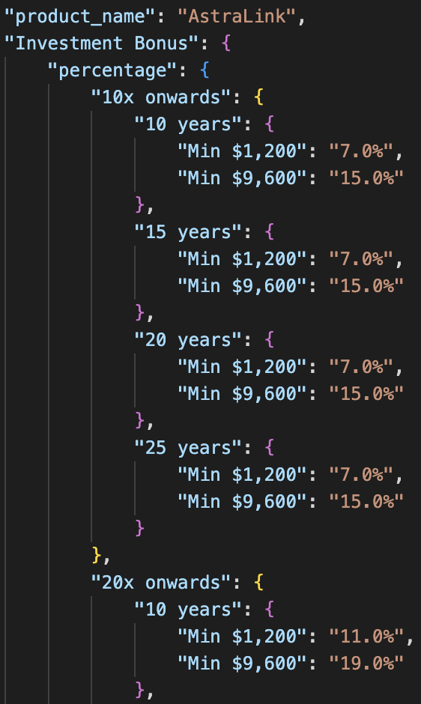
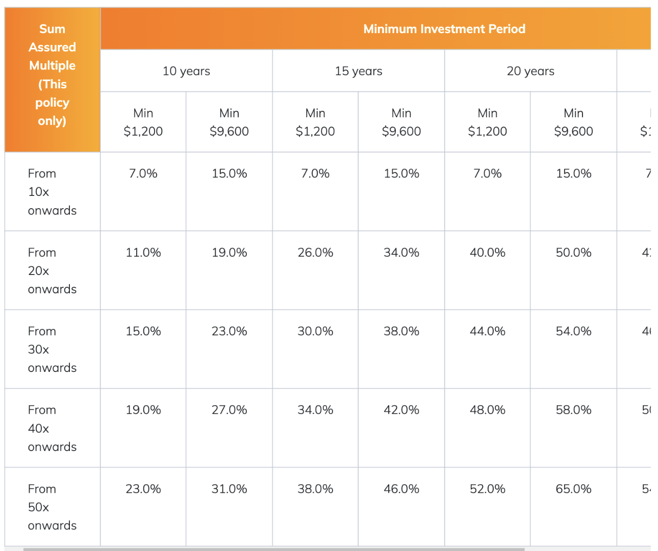
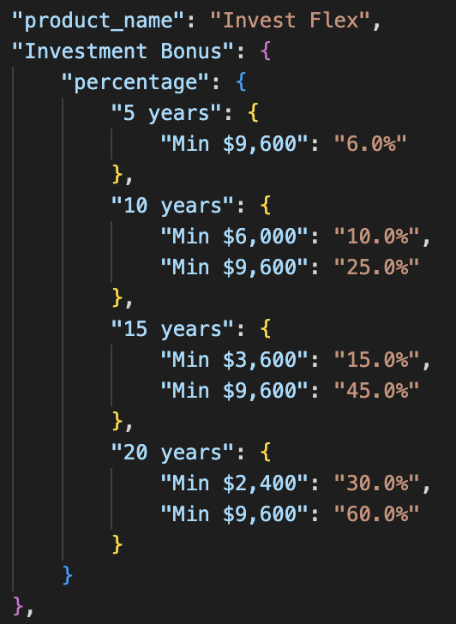
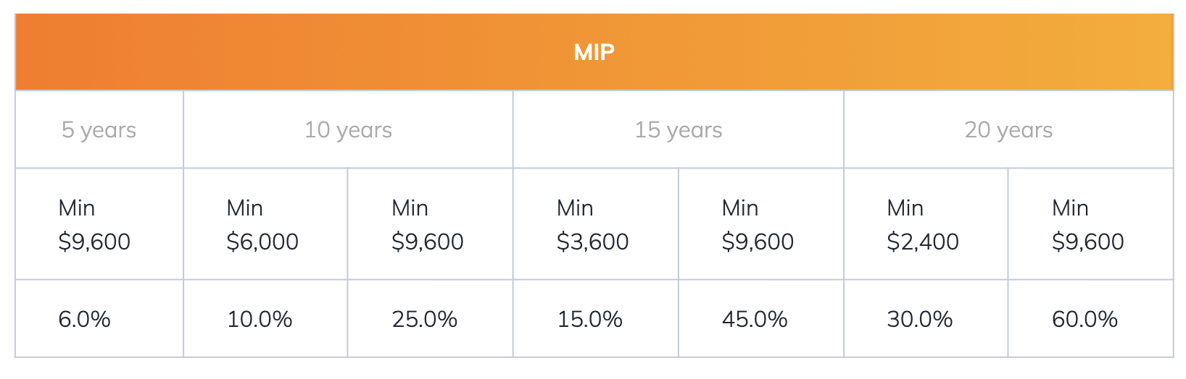
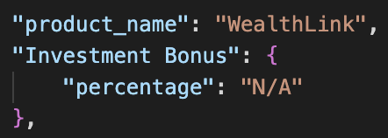

Investment-Linked Policies Example
The investment bonus is a percentage of the regular premiums paid during the first 12 months of the policy term, used to buy additional units in the chosen investment funds. The percentage varies based on the Minimum Investment Period (MIP) and annualized regular premiums.
Astralink | Invest Flex | WealthLink

Slide 6
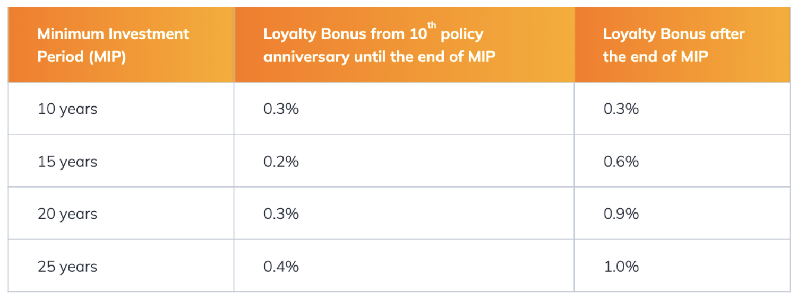
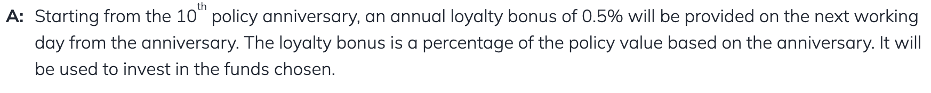
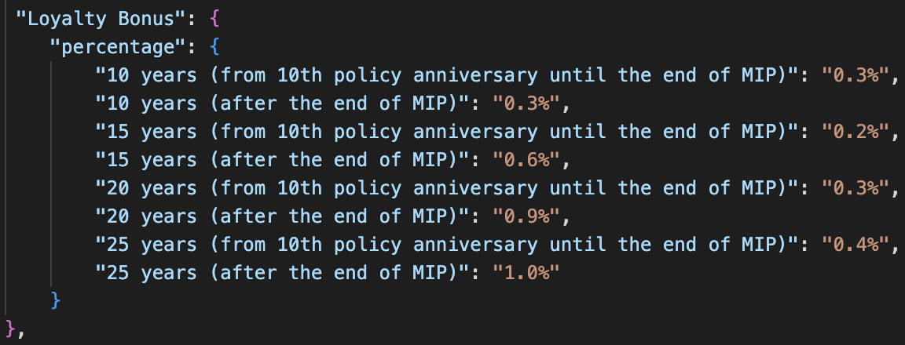
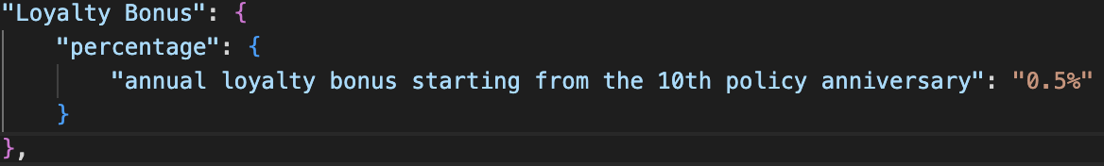
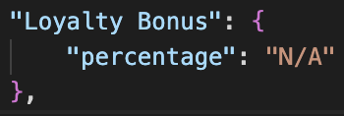
Investment-Linked Policies Example
The loyalty bonus is an annual bonus starting from the 10th policy anniversary. The loyalty bonus will be provided on the next working day from the anniversary.
The loyalty bonus is a percentage of the policy value based on the anniversary. It will be used to invest in the funds you have chosen.
Astralink | Invest Flex | WealthLink
I want Astralink

Slide 7





Overall Design Flow
Ingest policy conditions only
Ingest Data
For each policy, Extract benefits from “What your policy covers”
Reiterate for different configurations and approaches for performance improvement
Parse, Chunk, Index
Embed to Vector Store
Embed Query to get Standardized benefits
Prompt Engineering
Query and Retrieve
Extract and save as JSON from Generated Response
Evaluate based on completeness, accuracy and important fields (outputs a weighted score)
Compile JSON files and
convert into structured CSV file

Slide 8


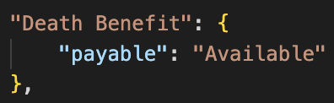
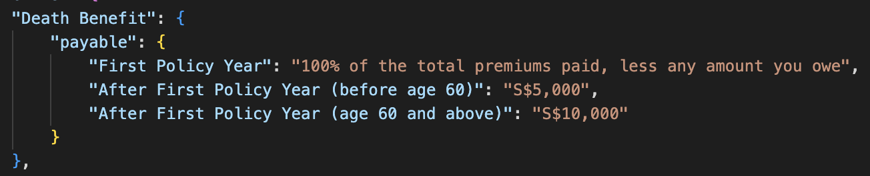
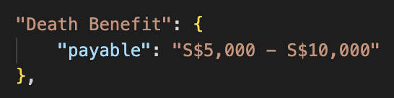
Challenges
Challenges | Steps Taken
Complexity of Documents Processing the various PDF files presented a significant challenge, especially so for multi-column files. | Experimented with LlamaParse, PyMuPDF4LLM, and Unstructured.io to identify the best tool for handling the files.
Chunking Given the length and complexity of the documents, various inbuilt chunking methods split important contextual information or included irrelevant data, leading to suboptimal performance. | Wrote a custom chunking methods by splitting FAQ documents based on questions. Converting documents into markdown before using LlamaIndex's MarkdownNodeParser to retain structure and hierarchy, maintaining contextual integrity.
Prompting This project requires very precise outputs. When capturing details like benefits (e.g., death benefit) or investment bonus, the output must be meaningful and include specific values rather than just stating a benefit is available or providing a range. | Broke down complex prompts into smaller, manageable steps to improve precision. Developed tailored prompts for different policy types, enhancing the relevance and accuracy of the extracted information. Iterative Testing

Slide 9
Thank You!
Notes:
V7 – Cover without image

